Slide 1

Do you enjoy a nice big cup of Coffee in the Morning?

Slide 2

Sometimes you may feel like this…

Slide 3
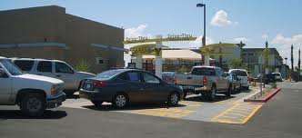
Do you hate sitting in lines like this?

Slide 4

Well we have a Dunkin solution for you!

Slide 5
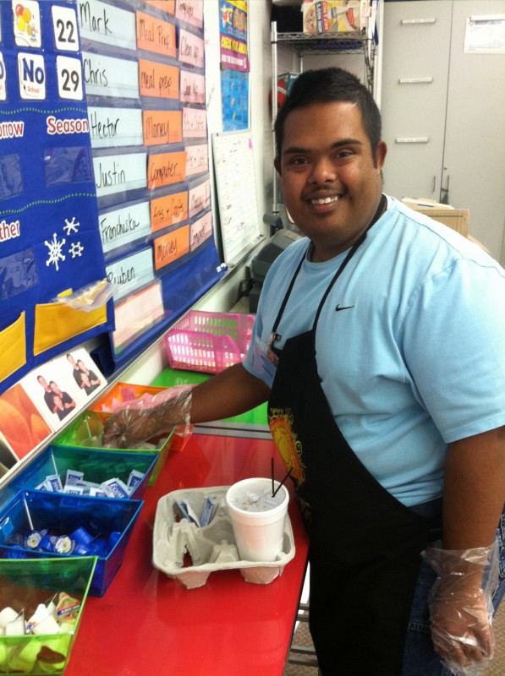
Our students at Jaw-va Café will deliver to you!

Slide 6
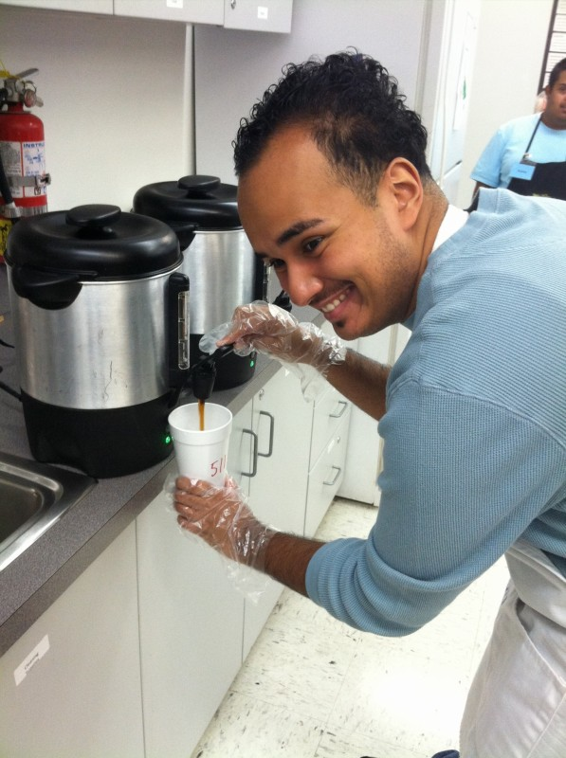
We will make and deliver coffee to your room for as little as $1.00
16 oz cup

Slide 7
We will be opening our doors September 8th during 1st period only.
We are located in room 204
You can order over the phone or by email katie.clark@sdhc.k12.fl.us

Slide 8
Can I order for my students?
-Teachers may order for their class.
-We have a limit of 5 the day of.
-Email the day before if you would like to use it as a class reward.
-If you don’t want to be bothered by your students…
We sell 12oz drinks after 1st period during the passing time to students.

Slide 9

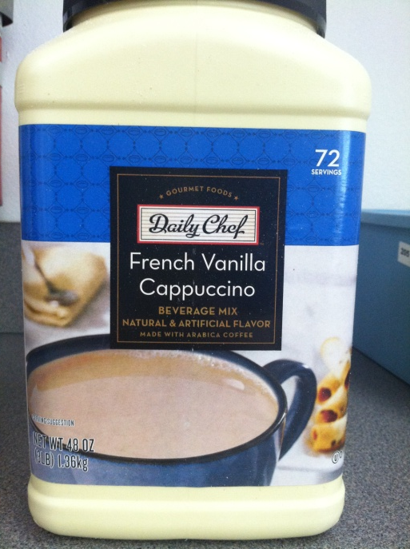
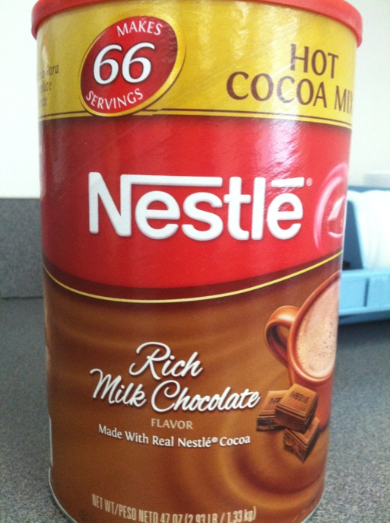
Here’s what we have…

Slide 10
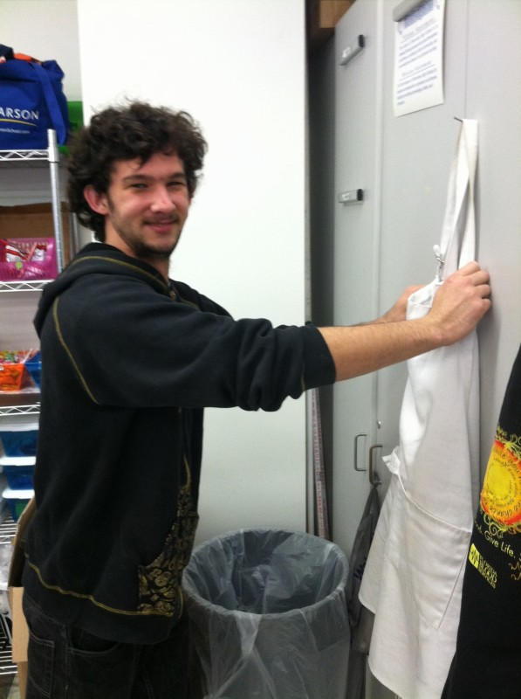
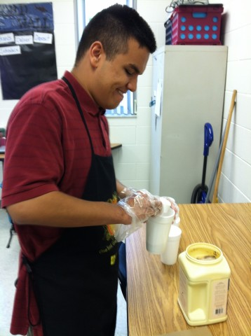
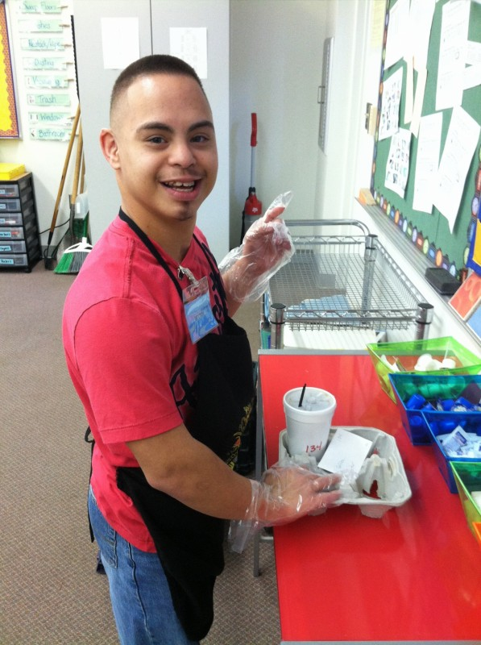
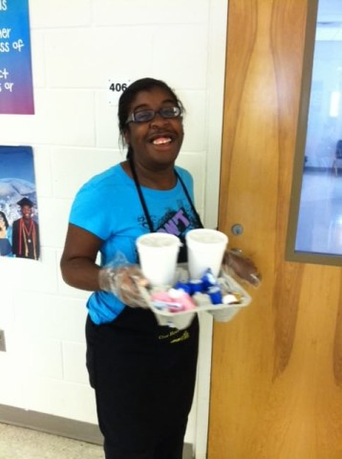
Our employees enjoy their jobs and look forward to serving you.

Slide 11
Here is how you can help us
Please order over the phone or through email. Our students cannot take orders in the hallway
If you want to order drinks for students in your room as a reward and its over 5 drinks please let us know the day before so we can prep.
Make sure our students are doing what they are supposed to:
- wearing their uniform (name tag, apron, gloves)
- walking not running
- self-advocating if they need help or just communicating appropriately
- doing their job and not disrupting your class
- Only teachers may place orders (NOT Students)

Slide 12
How do I know I got the right order?
Your name or room number/location will be written on your cup
What if I don’t carry CASH?
We take checks made out to Riverview High
Can I pay in advance?
-You sure can! Your name, room number and payment amount is added to our coffee board.

Slide 13
Your orders help our students:
Learn the responsibilities of a job
Give a feeling of self worth
Make money to pay for items needed for the classroom and/or students
Make money to help pay for Community Based Trips and items for students while out in the community (I will post pictures to Shark Pool so you can see the impact of your purchase)

Slide 14
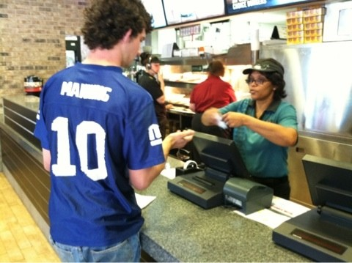
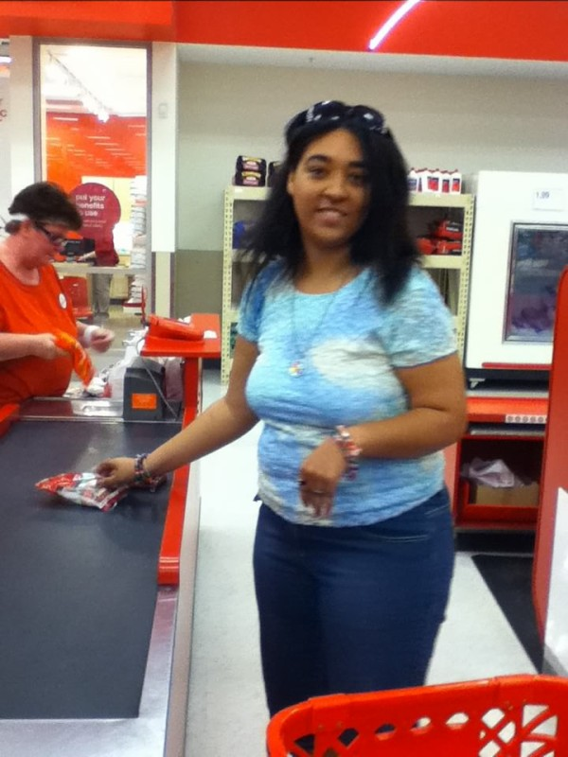
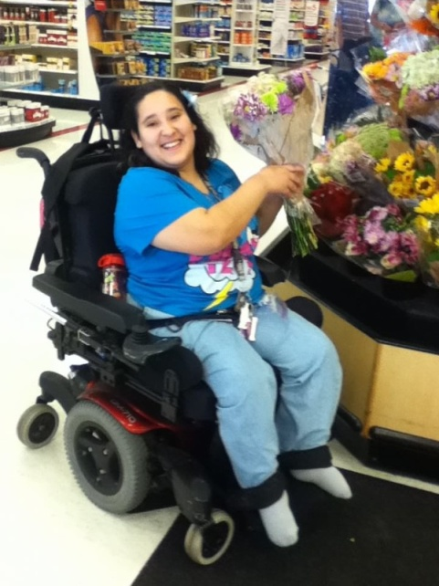
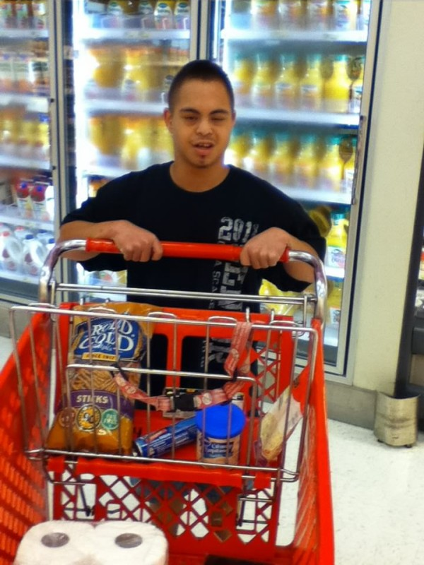
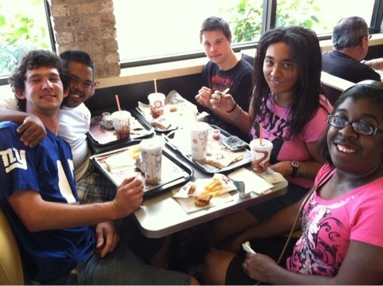
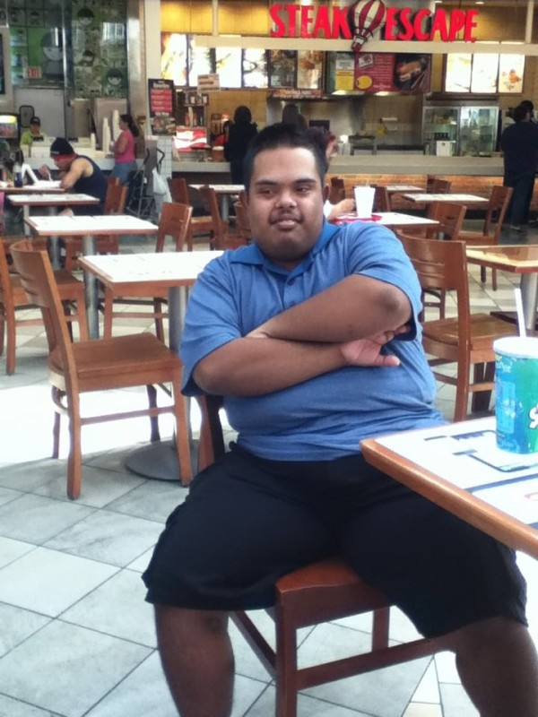
Thank you for your support

Slide 15
