Slide 1
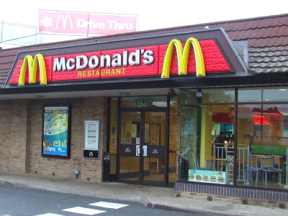
Going to McDonald’s

Slide 2
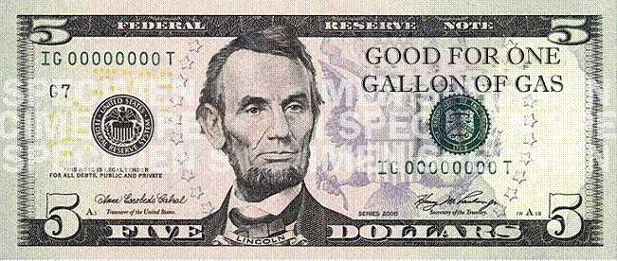
How can we be prepared for McDonalds?

Slide 3
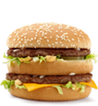


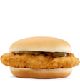
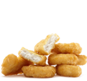
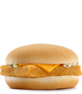
Use your practice menu to help you order your food.
Meals – Comes with a drink and fries
#1 Big Mac Meal $5.19
#2 Quarter Pounder Meal $5.19
#4 Big n’ Tasty Meal $5.19
#8 Southern Style Ckn Meal $5.29
#10 10 pc Chicken McNuggets $5.29
#11 Filet-o-fish Meal $4.89

Slide 4

Speak loudly to the cashier so that they can hear you.

Slide 5
Next Dollar Up
$5.98
1 2 3 4 5 6 7 8 9

Slide 6
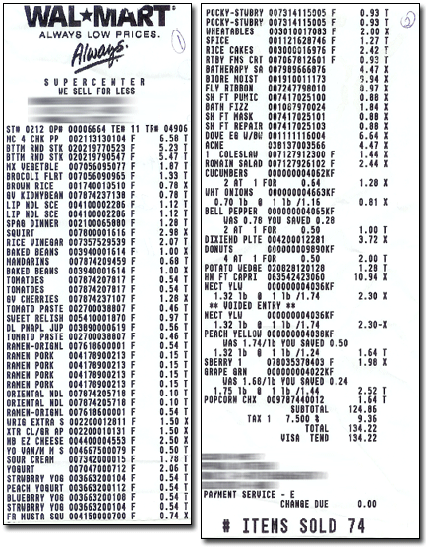
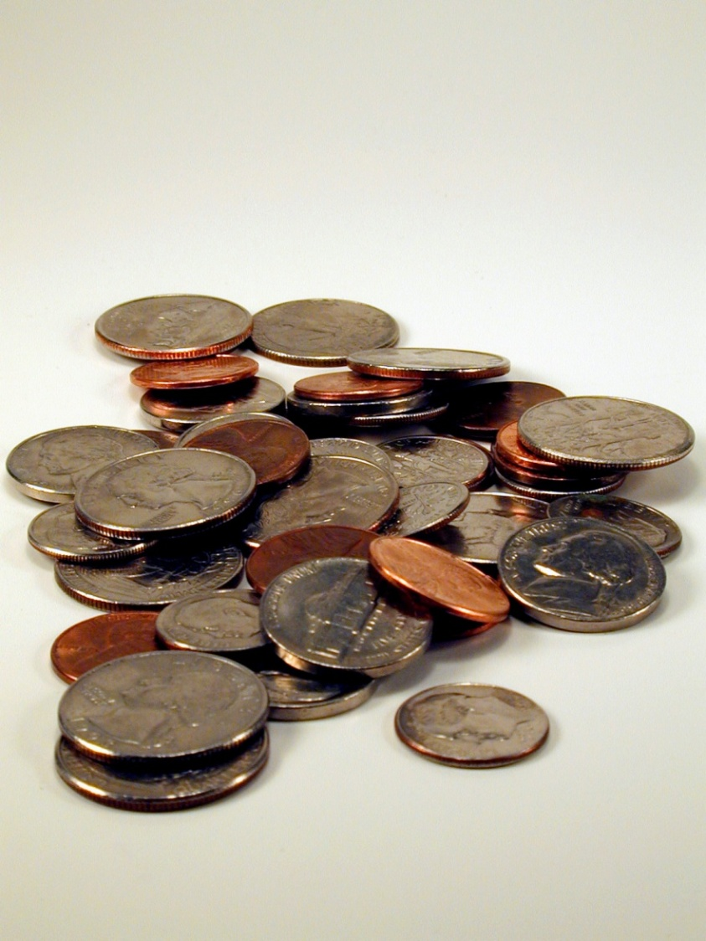
Remember to wait for change and a receipt.
Change
Receipt

Slide 7

Pick up your tray and carry it to the drink fountain.

Slide 8


Fill your drink

Slide 9
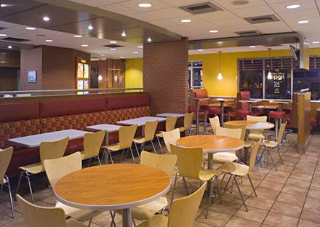
Find a place to sit with your peers.

Slide 10
Table Manners
Chew with my mouth closed.
Use a napkin to wipe my mouth and hands.
Keep my feet on the ground.
Take small bites.
Wait to talk when I have food in my mouth. I need to swallow first.

Slide 11


What can you talk about with your peers?

Slide 12
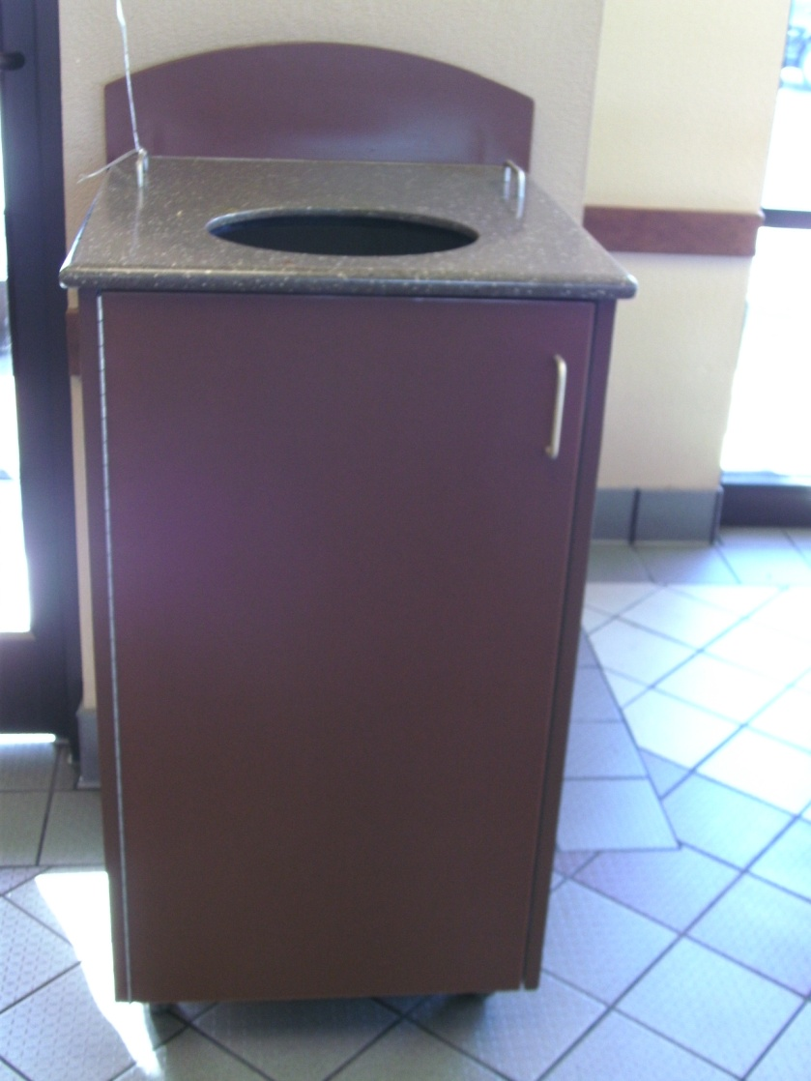
When you are finished with your food throw your trash away.

Slide 13
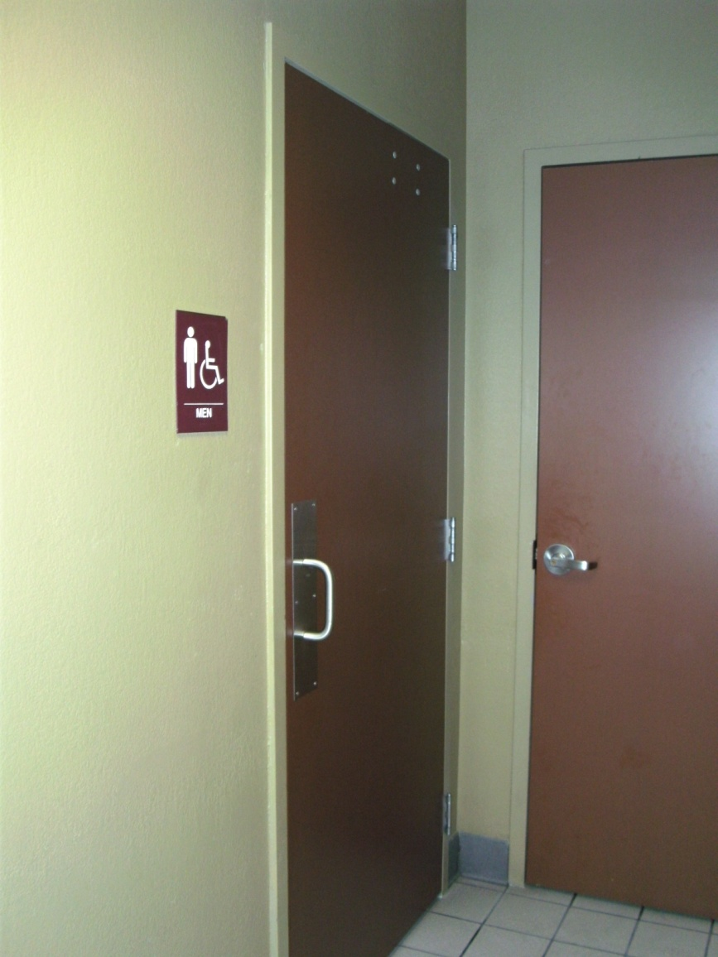
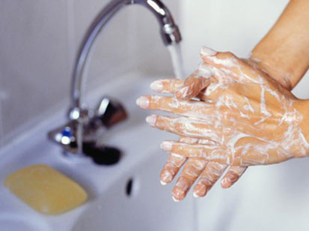
If you need to use the restroom let the teacher know.
I’m going to use the restroom.
Wash your Hands.
DO NOT RAISE YOUR HAND!

